Slide 1
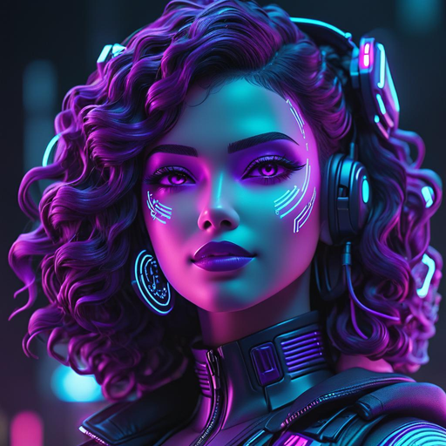
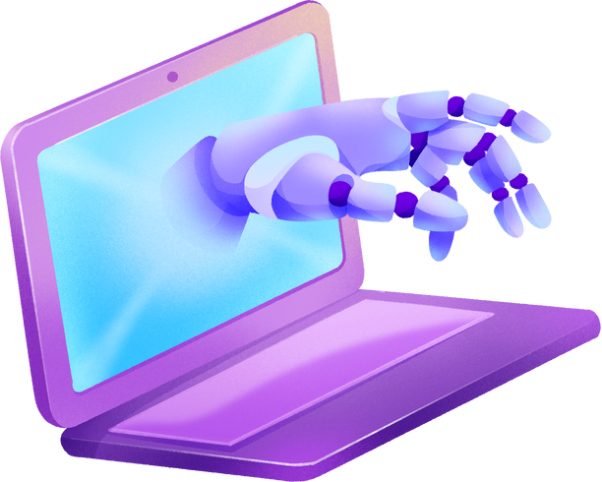
The Emergence of Mental Health Chatbots: A Modern
Era in Mental Health Assistance
Introducing ‘THERAPISIA’
A chatbot for mental health support

Slide 2
1.
ROSHINI RAJA
2116210701216
Team Members:
2.
SELVAN NANDHINI S 2116210701237
3.
SHAMINI P N
2116210701239

Slide 3
Abstract
Objectives
Introduction
Existing System
Agenda
Proposed System
System Architecture
Technology
Modules
Output Screenshots
Conclusion
References

Slide 4
ABSTRACT
Mental health is a major concern in today's environment.
With the world becoming more and more competitive every day, the number of people suffering from stress and other mental health issues is exponentially increasing.
There are various reasons why People get stressed.Like students get stressed for high expectations in academic performance, peer pressure, financial problems etc.
So,there are many chatbots available that do the work related to particular things like Chatgpt for content creation and blackbox ai for solving complex coding problems etc.

Slide 5
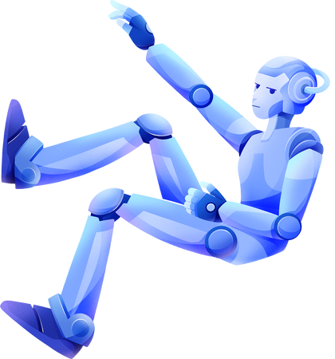
objectives
Usability and Accessibility
Empathy and Support
Flexibility and Adaptability

Slide 6
Mental health issues are a growing concern worldwide, affecting millions of individuals across various demographics.
Access to mental health care is often hindered by factors such as stigma, lack of availability, high costs, and geographical barriers. These challenges highlight the need for innovative solutions to provide timely and effective support.
There is a significant gap in accessible, immediate, and non-judgmental mental health support for individuals experiencing stress, anxiety, depression, and other mental health challenges.
PROBLEM STATEMENT

Slide 7
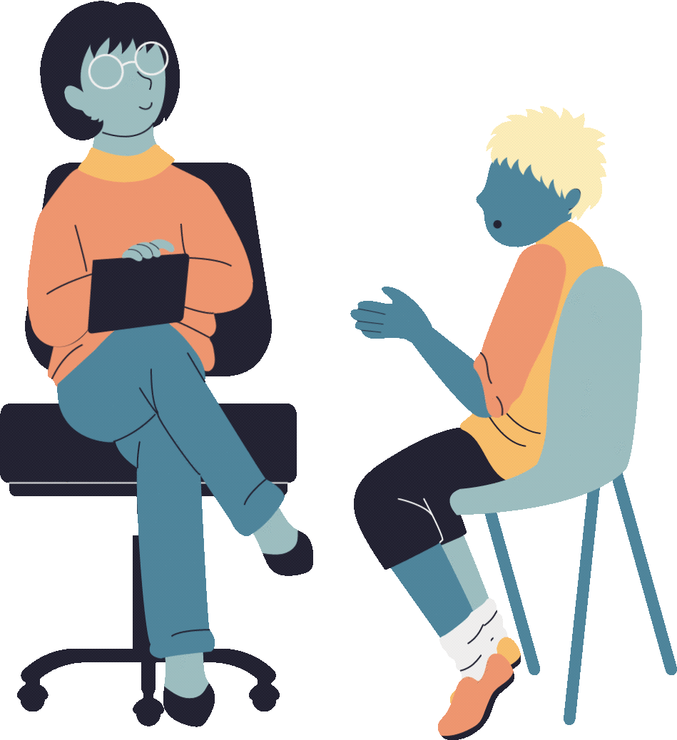
Existing System
Traditional Therapist Method/In-person Therapy
Teletherapy or online therapy platform
Crisis Intervention Services
Group and Peer Counseling
Employee Assistance Program
Existing Chatots
woebot
Youper
Wysa

Slide 8
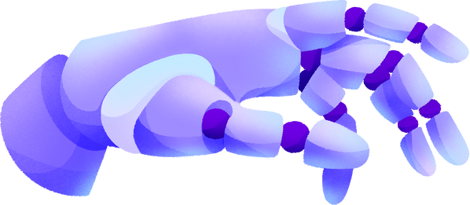

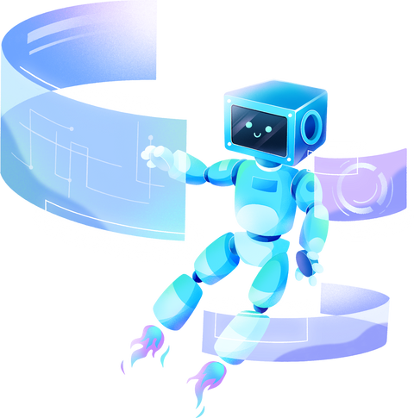
Proposed System
Our AI Mental health Chatbot Therapisia is developed using Gemini Pro.
Our chat interacts with user and offers advice and suggestions for their queries.
It is available 24/7 so the user can use it anytime.
Free cost for all users
User-Friendly access

Slide 9
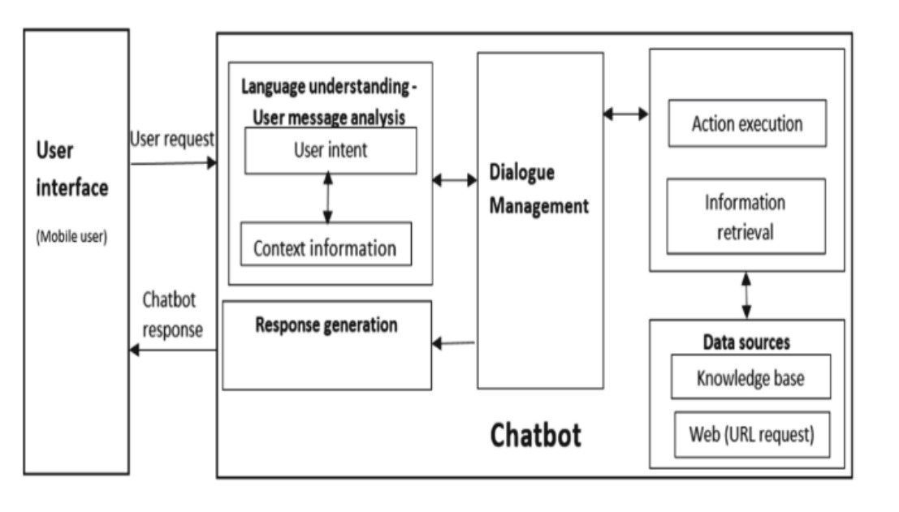
System Architecture

Slide 10
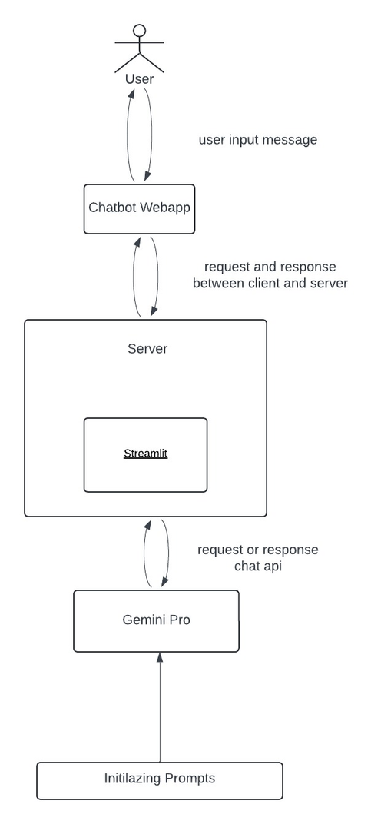
System Architecture

Slide 11

Technology used

Slide 12
REFRENCES

Slide 13
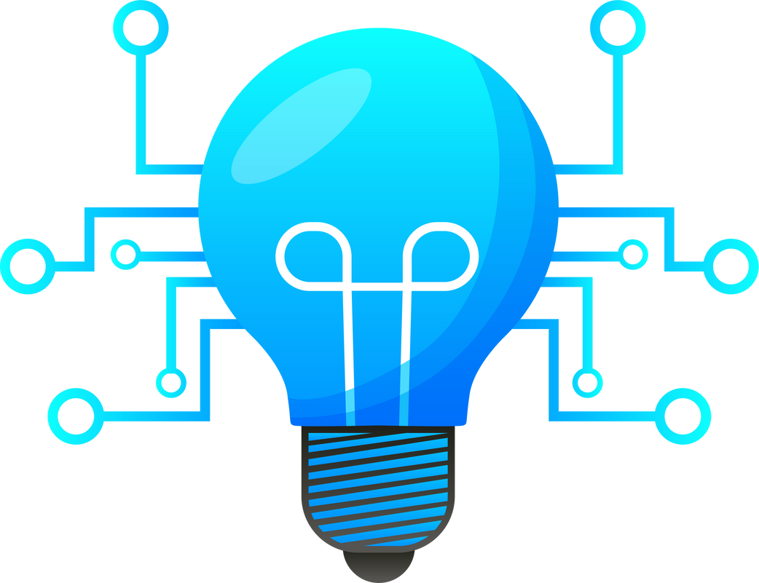

TECHNOLOGY USED
Google’s Gemini-Pro
Streamlit
Generative AI
Multimodal LLM generates various output.
Closed-source model
Open-source python library
To built attractive UI in no time
No prior experience in front-end
Compatible with major Libraries

Slide 14

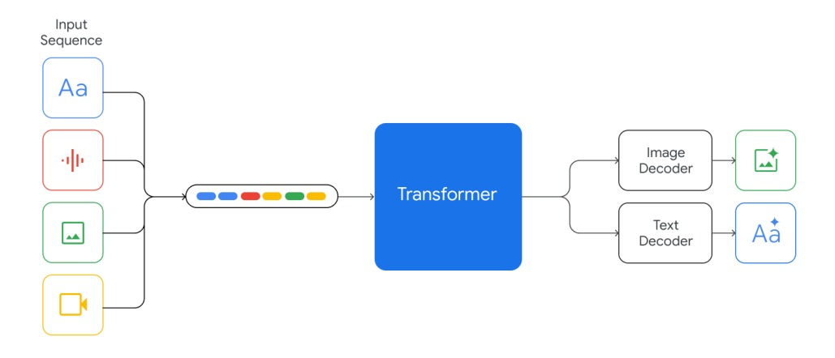
Gemini Diagram

Slide 15
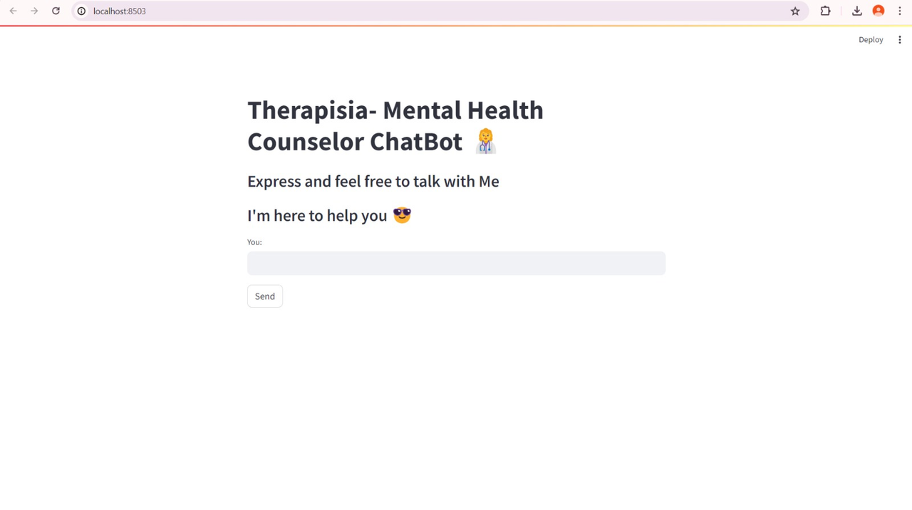
Modules
The user interface of a mental health chat bot app will be intuitive and calming.
Featuring a minimalist design Interactive elements like quick response buttons and
progress trackers enhance engagement and ease of use.
Fig 1. User interaction

Slide 16
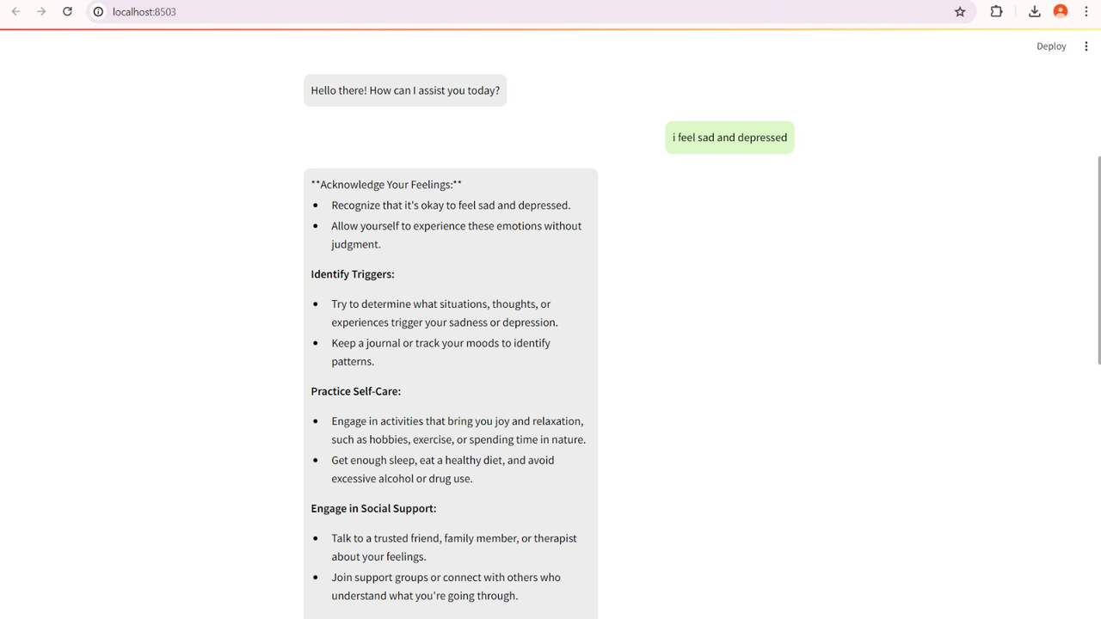
The chatbot response interface in our mental health chat app offers real-time support,
confidential space for individuals to share their thoughts and feelings.
Fig 2.Chatbot Response

Slide 17
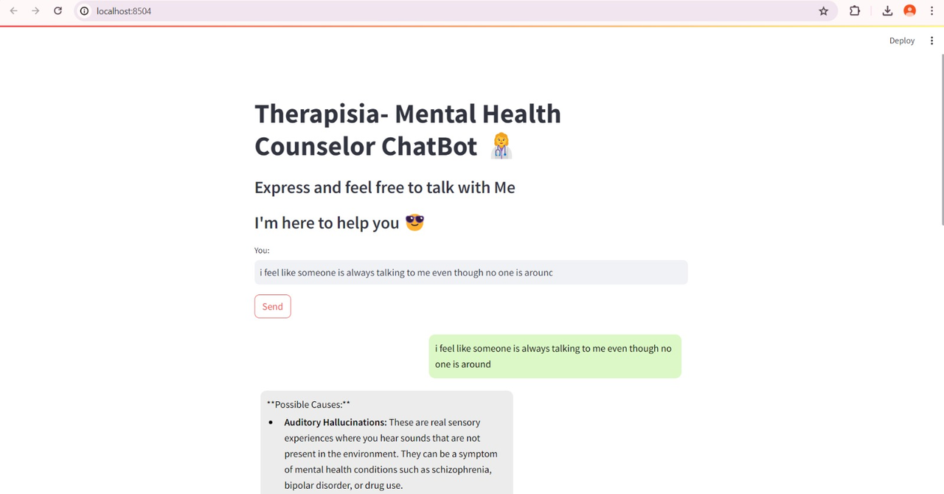
RESULTS:
Thus the model generate responseby
analyzing and understanding based on user input prompt

Slide 18
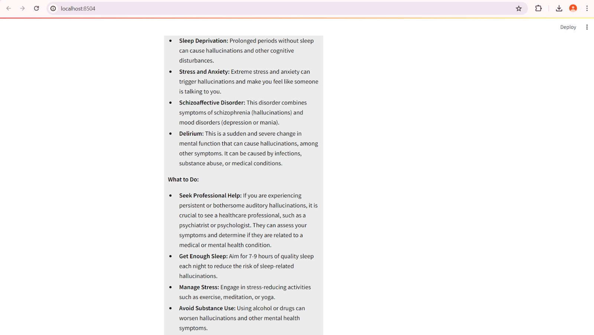

Slide 19
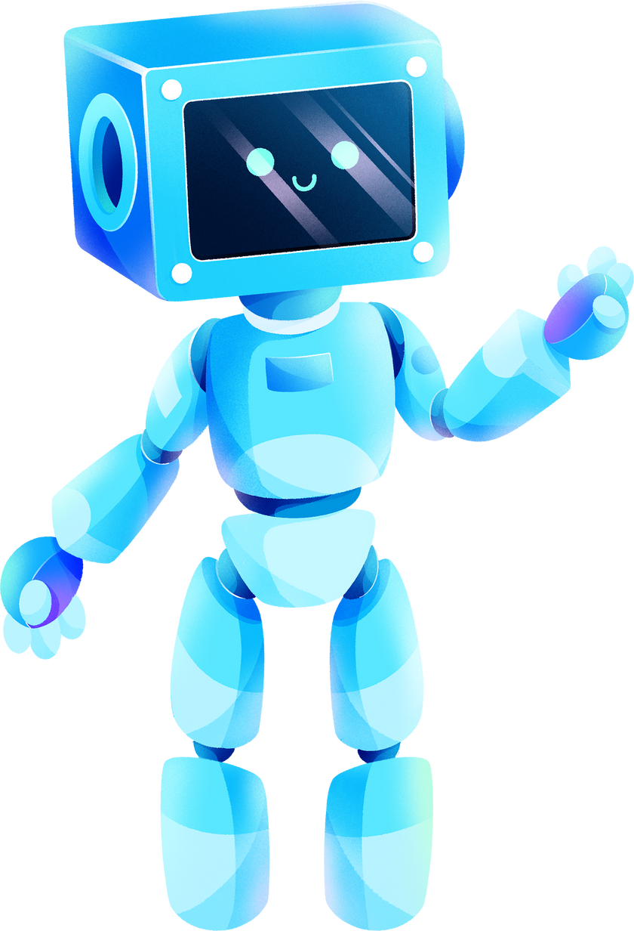
Conclusion:
A mental health chatbot Therapisia powered by Gemini Pro has some great benefits.
It's there 24/7, so you can get help immediately without having to make appointments, which is helpful in tough times.
The chatbot can understand and respond to your emotions in a really human-like, caring way which makes you feel heard and supported.
It can handle all sorts of inputs making communication more effective.
Plus, it keeps everything anonymous, so you can open up without worrying about being judged or mistaken. And it's affordable, making mental health support available to more people. Overall, it's always there for you, it is understanding and flexible. It is also cost -effective which makes everybody use it.

Slide 20

Future enhancements
Voice Integration
Color Changing
Notification
enabling voice assistant feature to more personized interaction.
provides happy colors theme in the chat background to improve the mood
Briefly elaborate on a milestone the company achieved in this period.

Slide 21
REFRENCES
H. M. S. Ali, A. Rahman, F. M. M. Awal, "Chatbot for Mental Health Support Using NLP," 2021 IEEE Conference on Big Data and Analytics (ICBDA), 2021, pp. 123-128.
J. M. Anderson, L. M. Martin, R. A. Smith, "Advancements in Conversational AI: Building Mental Health Chatbot with NLP," 2020 IEEE International Conference on Artificial Intelligence (ICAI), 2020, pp. 189-194.
P. K. Gupta, S. L. Shah, "A Chatbot to Promote Students' Mental Health through Emotion Recognition," 2019 IEEE Xplore Conference on Education and Research (ICER), 2019, pp. 56-60.
S. Das, K. M. Sharma, A. J. Patel, "CareBot: A Mental Health ChatBot," 2022 IEEE International Conference on Computer Applications (ICCA), 2022, pp. 110-115.
R. N. Dutta, S. K. Tiwari, "Health Care Chatbot using Natural Language Processing," 2021 IEEE Xplore Conference on Health Informatics (ICHI), 2021, pp. 201-207.

